Slide 1
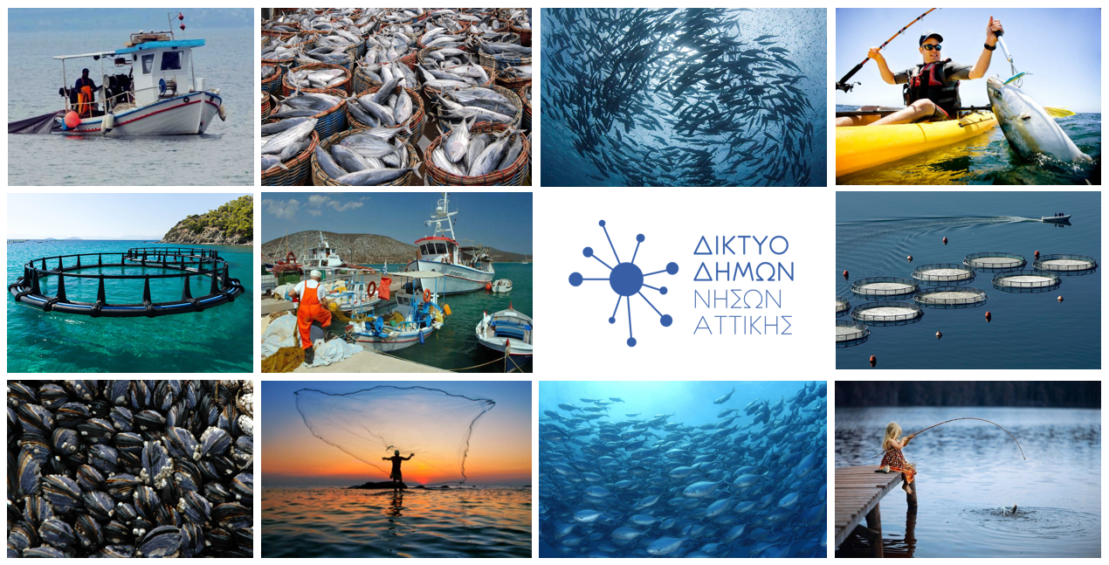
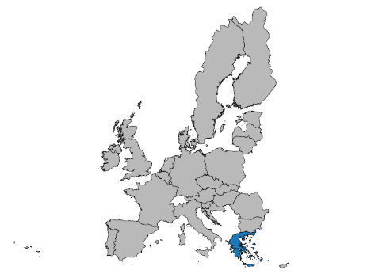
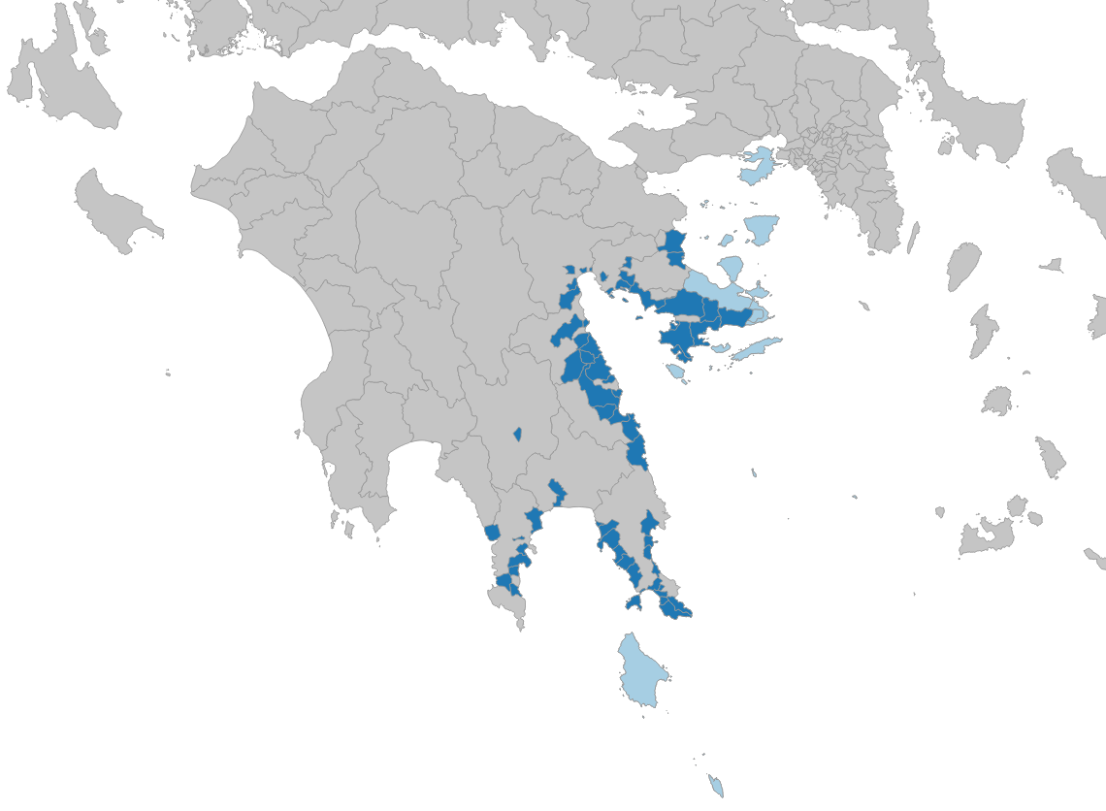
Entrepreneurship Incubator based on Aquaculture
The purpose of this Inter-regional Project among Attica Islands Network LAG and Parnonas LAG, with a robust potential of becoming a Trans-national Project, is to create an organizational informational, educational and networking structure for entrepreneurs, the local population and local economy actors on entrepreneurship and advice in the field of fish farming and the development of new professional activities in the fisheries sector. The aim of the Project is to highlight the fish farming sector and the prospects it presents, to enhance entrepreneurship and cooperation and to create new job opportunities. Considering that the fish farming sector is an important lever for the Greek economy, local prospects can be created for further growth, boosting entrepreneurship and creating new jobs. These perspectives can be created through the Incubator which will be an organizational informational, educational and networking structure for young entrepreneurs, businesses and the local population.
Indicatively, the actions of the project include, but are not limited to:
Training, awareness raising, know-how transfer and advisory services on entrepreneurship in the field of Aquaculture. Development of educational and informational material on business innovation in aquaculture
Networking among businesses and local stakeholders in order to foster extroverted growth
Workshops to raise the awareness of the local population on business activity matters
Implementation of fish product- based events (tasting, documentary projections, etc.)
Implementation of thematic trans-national and inter-regional schools (e.g. Sea Bottom School, etc.)
Expected results from cooperation for the region
Exploitation of public financial recourses in port infrastructure.
Improve management and operation services.
Emphasizing the needs for improvements and modernizations, based on the needs of the specific market.
Integration of the protective object of the ancient antiquities into the tourist product.
Total estimated budget: 100,000 € for two partners
CLLD under the European Maritime and Fisheries Fund 2014-2020
Eastern Peloponnese & Attica Islands Local Program
Entrepreneurship Incubator based on Aquaculture
(Inter-territorial project)
Regional Development Company
Of Parnonas S.A.
Leonidio Arcadia, P.O. 22300
Tel. 27570-22807, Fax. 2757023230
Mail: info@parnonas.gr
Web: www.parnonas.gr
Attica Islands Network
Filonos 91, 185 35, Piraeus
Tel. 2104120002-4-9
Fax. 2104120006
Mail: info@atticalag.gr
Web: www.atticalag.gr

Slide 2
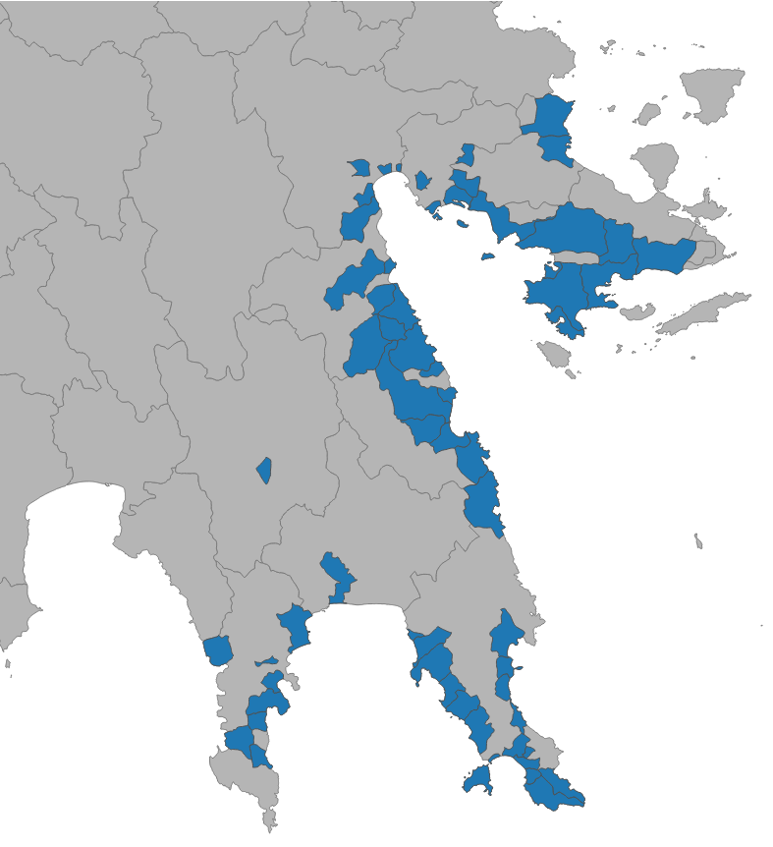
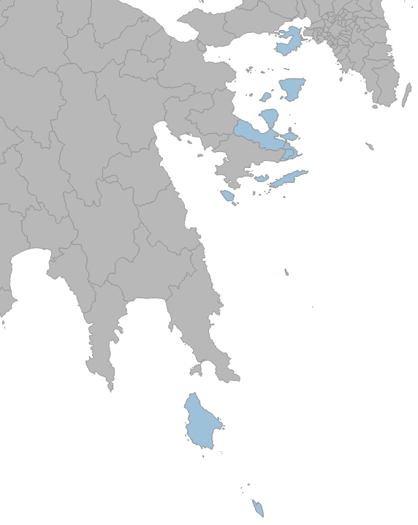
Parnonas LAG & Attica Islands Network LAG
Parnonas LAG & Attica Islands LAG CLLD EMMF 2014-2020 Intervention Area
The Development Company of Parnonas SA and Attica Islands Network are two Local Authorities companies and Local Action Groups operating in the Eastern Peloponnese region and in the Attica Islands regional unity. The Development Company of Parnonas SA consists of 13 municipalities and other socio-economic actors and Attica Islands Network consists of 8 municipalities, 1 development company and 11 social actors. The purpose of the civil Association entitled as ‘’Attica Islands Network’’ is social and developmental and in no case is considered as profit / commercial. Moreover, the purpose of the two Local Action Groups is to design and implement the local development strategy for the integrated rural development of the Eastern Peloponnese and the Attica Islands by developing complementary and alternative agricultural activities in the export orientation of agricultural production through the qualitative upgrading and promotion of characteristics of the region (cultural tradition, natural environment, gastronomy, architectural heritage, port infrastructure) . physical and European Community funds and also through Measure 19 of the Rural Development Program, the National Pact Partnership 2014-2020 and Priority 4 of the Operational Programme for Fisheries and Sea ( OPFS) 2014-2020.
Parnonas LAG (Eastern Peloponnese) ​​implementation area of the Local CLLD Fisheries Program which is funded by the Operational Programme for Fisheries and Sea ( OPFS) 2014-2020, includes the fishing communities of Argolida, Arcadia and Laconia, with a total area of 1.725,7 km2 and a population of 66,011 inhabitants and Attica islands regional unity consists of Local Fisheries Communities such as : Salamina, Agistri, Aegina, Poros, Hydra, Spetses, Kythira and Antikythira, as well as the Methana peninsula and the mainland in the interior of Troizina. The implementation area covers an area of ​​~ 879,16 km2 and has a population of 74,651 inhabitants.
The Local Fisheries Communities of the Local CLLD Fisheries Program are presented in the following maps:
CLLD Fisheries of Attica Islands LAG
CLLD Fisheries of Parnonas LAG
In this framework of implementation of the Local Fisheries CLLD Programs 2014-2020, the region of the Eastern Peloponnese and Attica Islands, having a common maritime area and in the effort to manage their common resources, will cooperate in an inter-regional cooperation project entitled as "Entrepreneurship Incubator based on Aquaculture".
Parnonas LAG & Attica Islands LAG Local Program CLLD EMMF 2014-2020
Fishermen, Fisheries & Fishing Areas
The Local Programs of Parnonas LAG and Attica LAG, CLLD 2014-2020 , are multi-sectoral and multi-funded (EAFRD & EMFF) and were approved with an initial public expenditure of 11.700.000€ for Parnonas LAG and 7,400,000€ for Attica LAG of which 2,800,000€ and 2,350,000€ respectively were financed by the European Maritime and Fisheries Fund (EMFF) for the implementation of the CLLD Fisheries 2014-2020.
In the fisheries sector, the types of active operators in the intervention area are: fish farms, small-scale fishing enterprises (fishermen) and tourism enterprises. The particular challenges that the region faces are the greater citizen participation, the promotion of the region's identity, diversification and adaptation of activities and services, enhancement of natural heritage etc.
Main Challenges:
Promoting youth entrepreneurship in the fisheries sector (high aging rate) - Reduction of unemployment
Diversification of the tourist product (fishing tourism)
Upgrading port and service infrastructure
Improving the quality of life of fishing areas
Conservation / protection of the marine environment
Based on the Hellenic Statistical Authority data. (2001,2011), the employment in the fisheries sector is decreasing year after year, which makes it necessary to strengthen the sector and the regions through actions of the 2014-2020 CLLD Fisheries Program. Specifically, the total employment of the Eastern Peloponnese in the fisheries sector is : 567 (Fisheries: 399, Aquaculture: 168, Edit: 0) and of the Attica Islands: 380 (Fisheries: 308, Aquaculture: 70, Processing: 2), while 10 years ago (2001), the number of employees was almost twice as high!
The actions of the program concern:
Creation and modernization of very small and small businesses by fishermen, regarding the diversification of their activities and supplementing their income
Establishment and modernization of very small and small businesses by non-fishermen in order to increase the added value of the region's fisheries (fisheries, aquaculture, processing)
Strengthening of infrastructure in order to support fisheries / aquaculture, encourage tourism and improve the quality of life in fisheries areas.

