Slide 1






Attica Islands Network of Municipalities
Local Program CLLD/LEADER:
«Nature & Culture “On Board”
INTERTERRITORIAL & TRANSNATIONAL PROGRAM
«Blue Growth Incubators Network»

Slide 2




Non-Profit Organization
Public benefit and development purpose driven

Slide 3
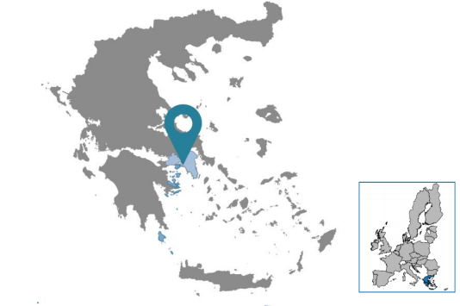
9.400.000€

Slide 4
8 Municipalities
10 Social actors
9.400.000€
1 Development company
2016
2017
2018
2019
2020
2021
2022

Slide 5


Private
AGRICULTURAL
63 investments
B/T: 6.694.527,08€
Public
SEA & FISHERY
74 investments
B/T: 5.129.140,42€

Slide 6
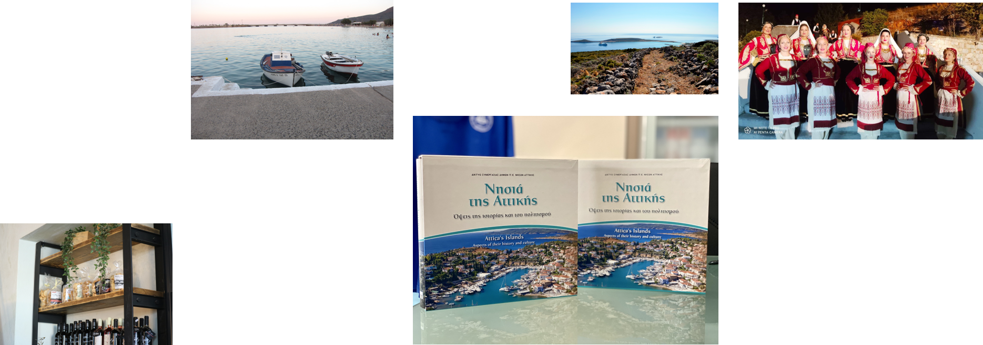
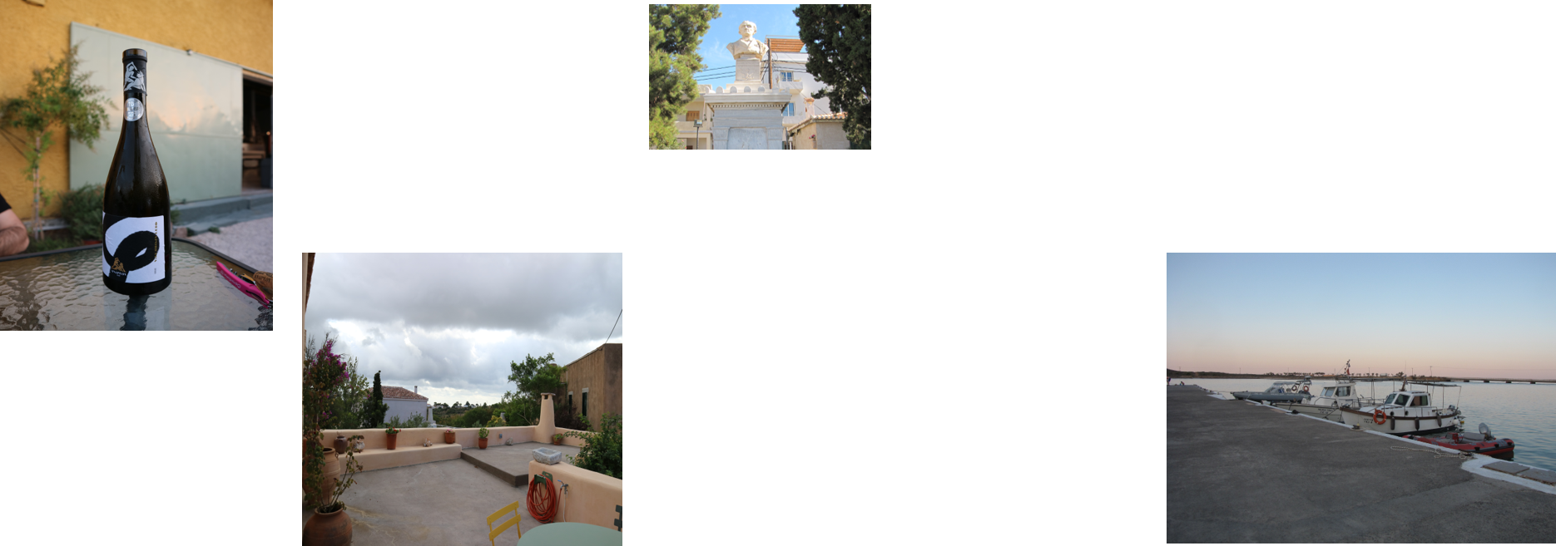

Slide 7
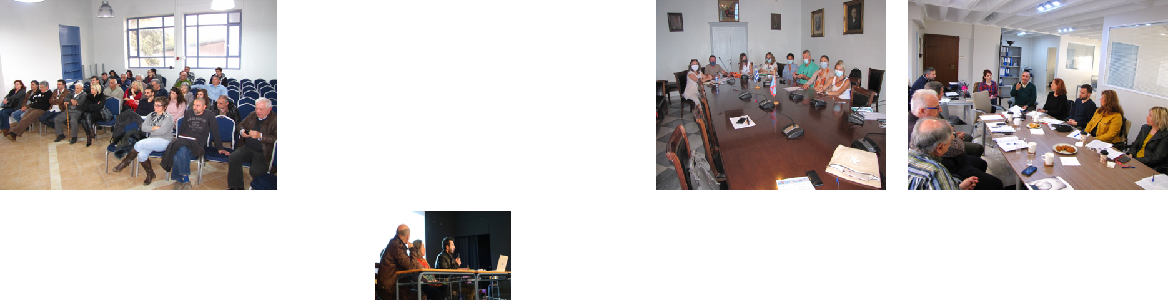
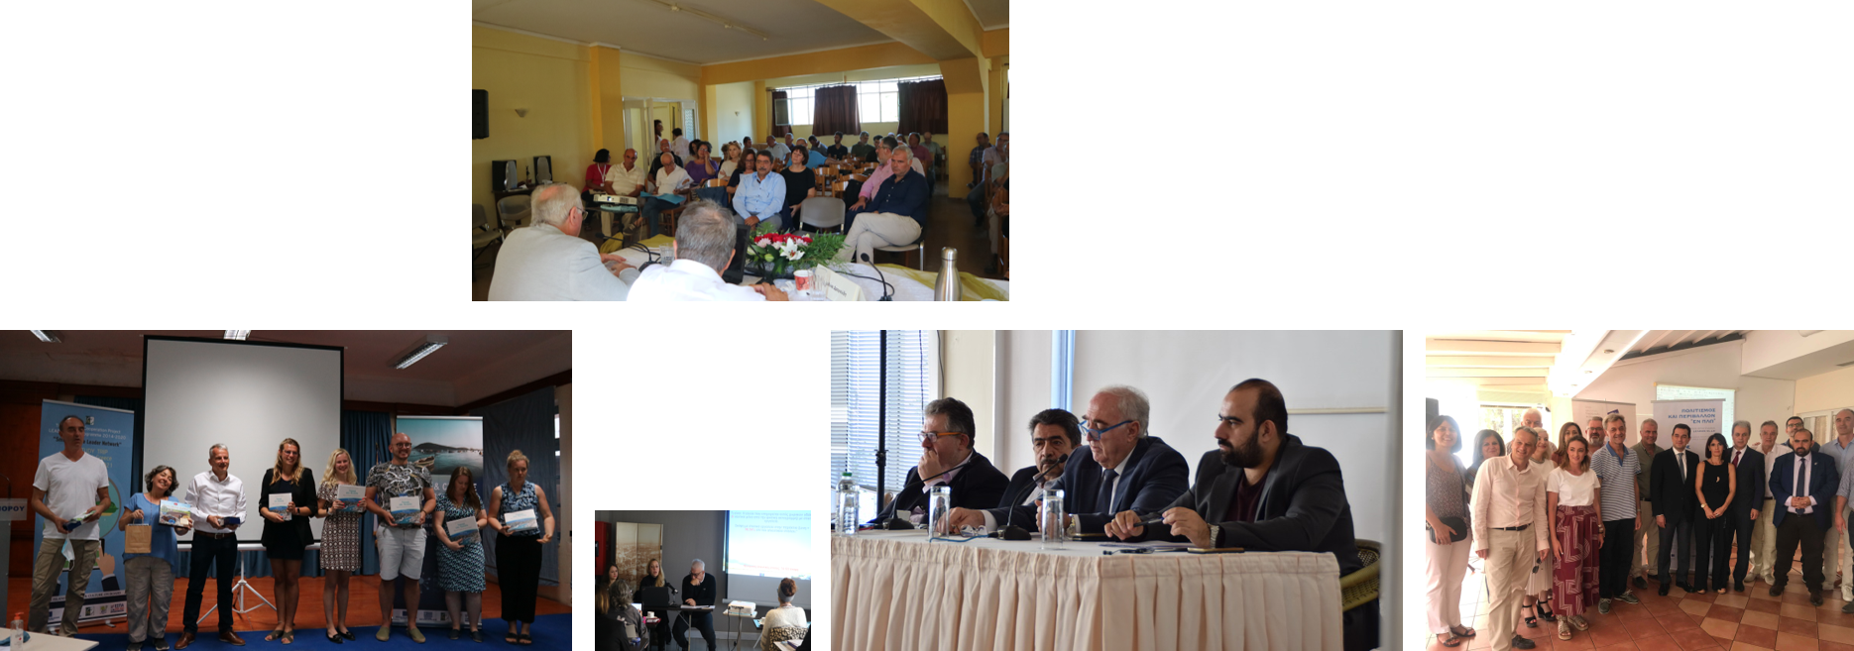
Informative Events

Slide 8
MEASURE 19: "Local Development at the Initiative of Local Communities LEADER / CLLD" of Agriculture Fund 2014-2020 | PRIORITY 4: "Increase of employment and territorial cohesion" of Sea & Fishery Fund 2014-2020 | Agriculture Fund (€) | Sea & Fishery Fund (€) | NATIONAL PARTICIPATION (€)
19.1: Preparation of the Local Program | 4.1: Preparation of the Local Program | 43.672,00 | - | 10.918,00
19.2: Private - Public Investments | 4.2: Local Development Implementation at the initiative of the Local Communities | 2.688.000,00 | 1.772.000,00 | 1.115.000,00
19.3: Inter-local - Transnational Plans | 4.3: Collaborative Activities | 168.000,00 | 108.000,00 | 69.000,00
19.4: Operating Expenses & Εncouragement | 4.4: Operating Expenses and Coordination | 1.184.000,00 | - | 296.000,00
TOTAL PUBLIC EXPENDITURE OF THE LOCAL PROGRAM |  | 7.400.000,00 €

Slide 9
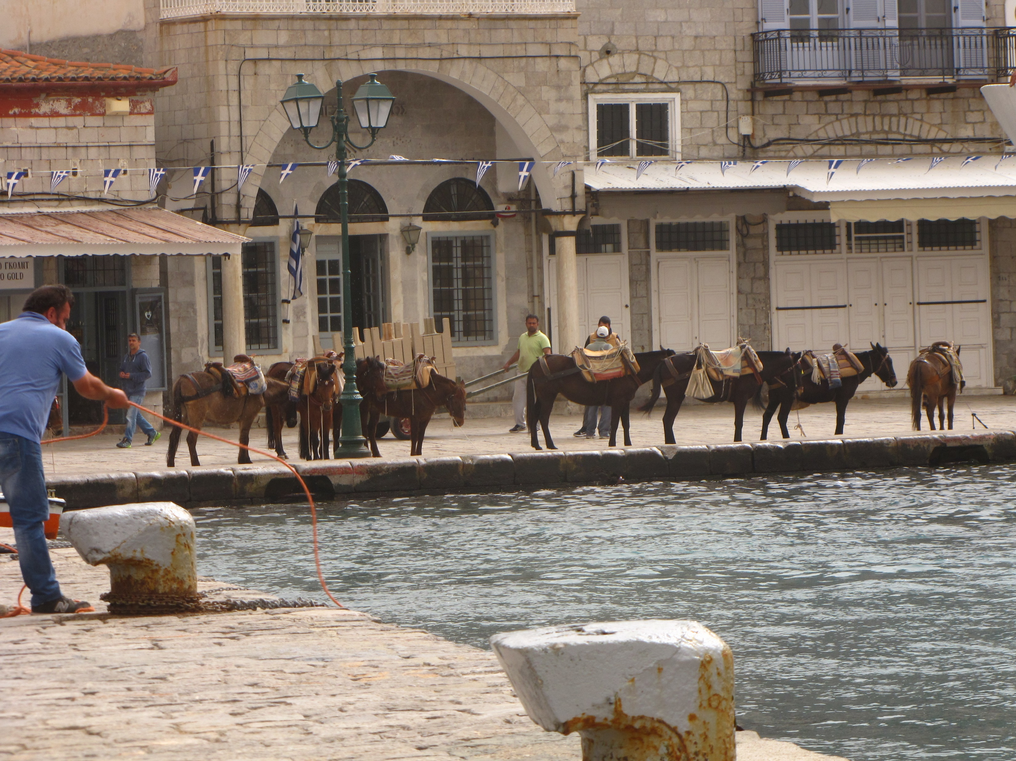
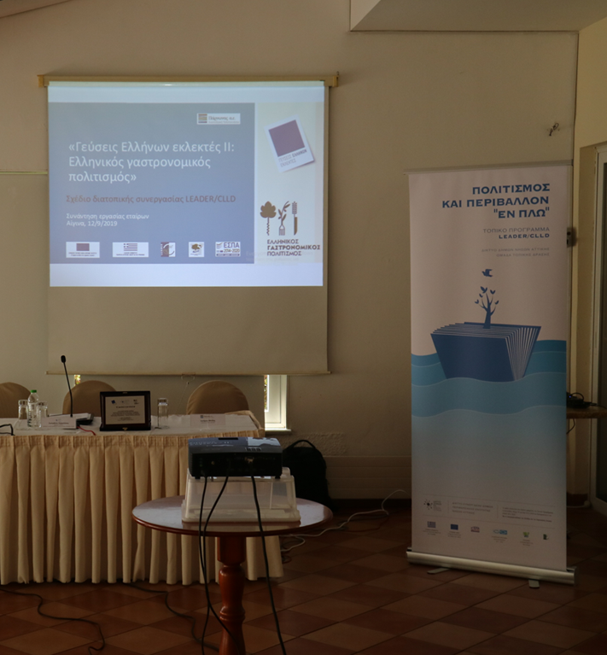
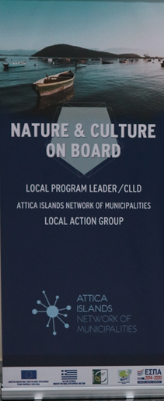
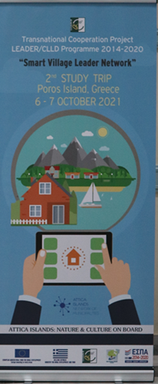
Biosphere Reserve
45.000,00€ | 4 LAG
Inter-local - Transnational | Agriculture Fund: € 210,000.00
Flavors of Greek Fine
80.000,00€ | 25 LAG
Smart Villages Leader Network
82.000,00€ | 5 LAG | Greece – Latvia – Finland – England

Slide 10
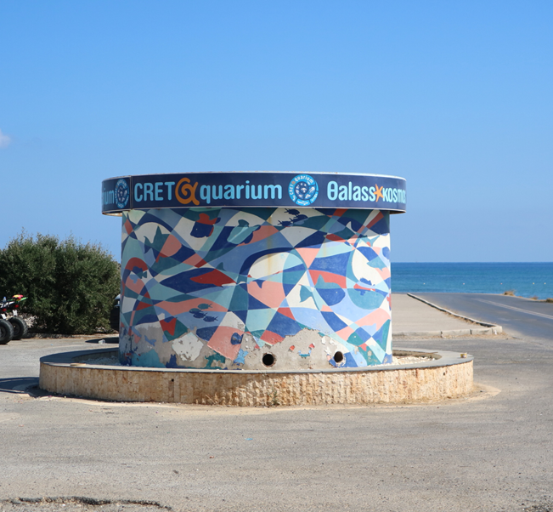
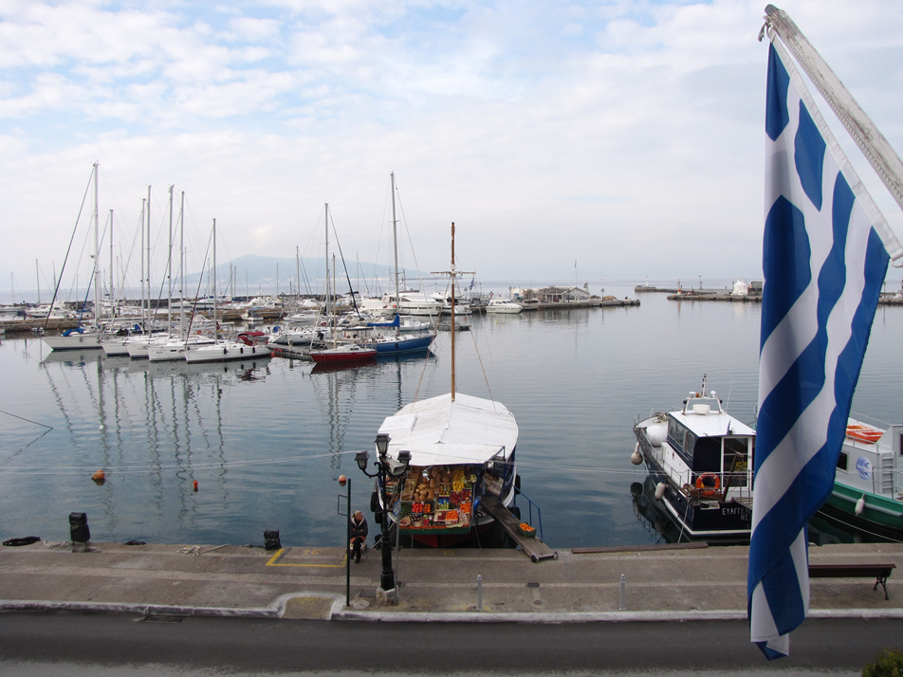
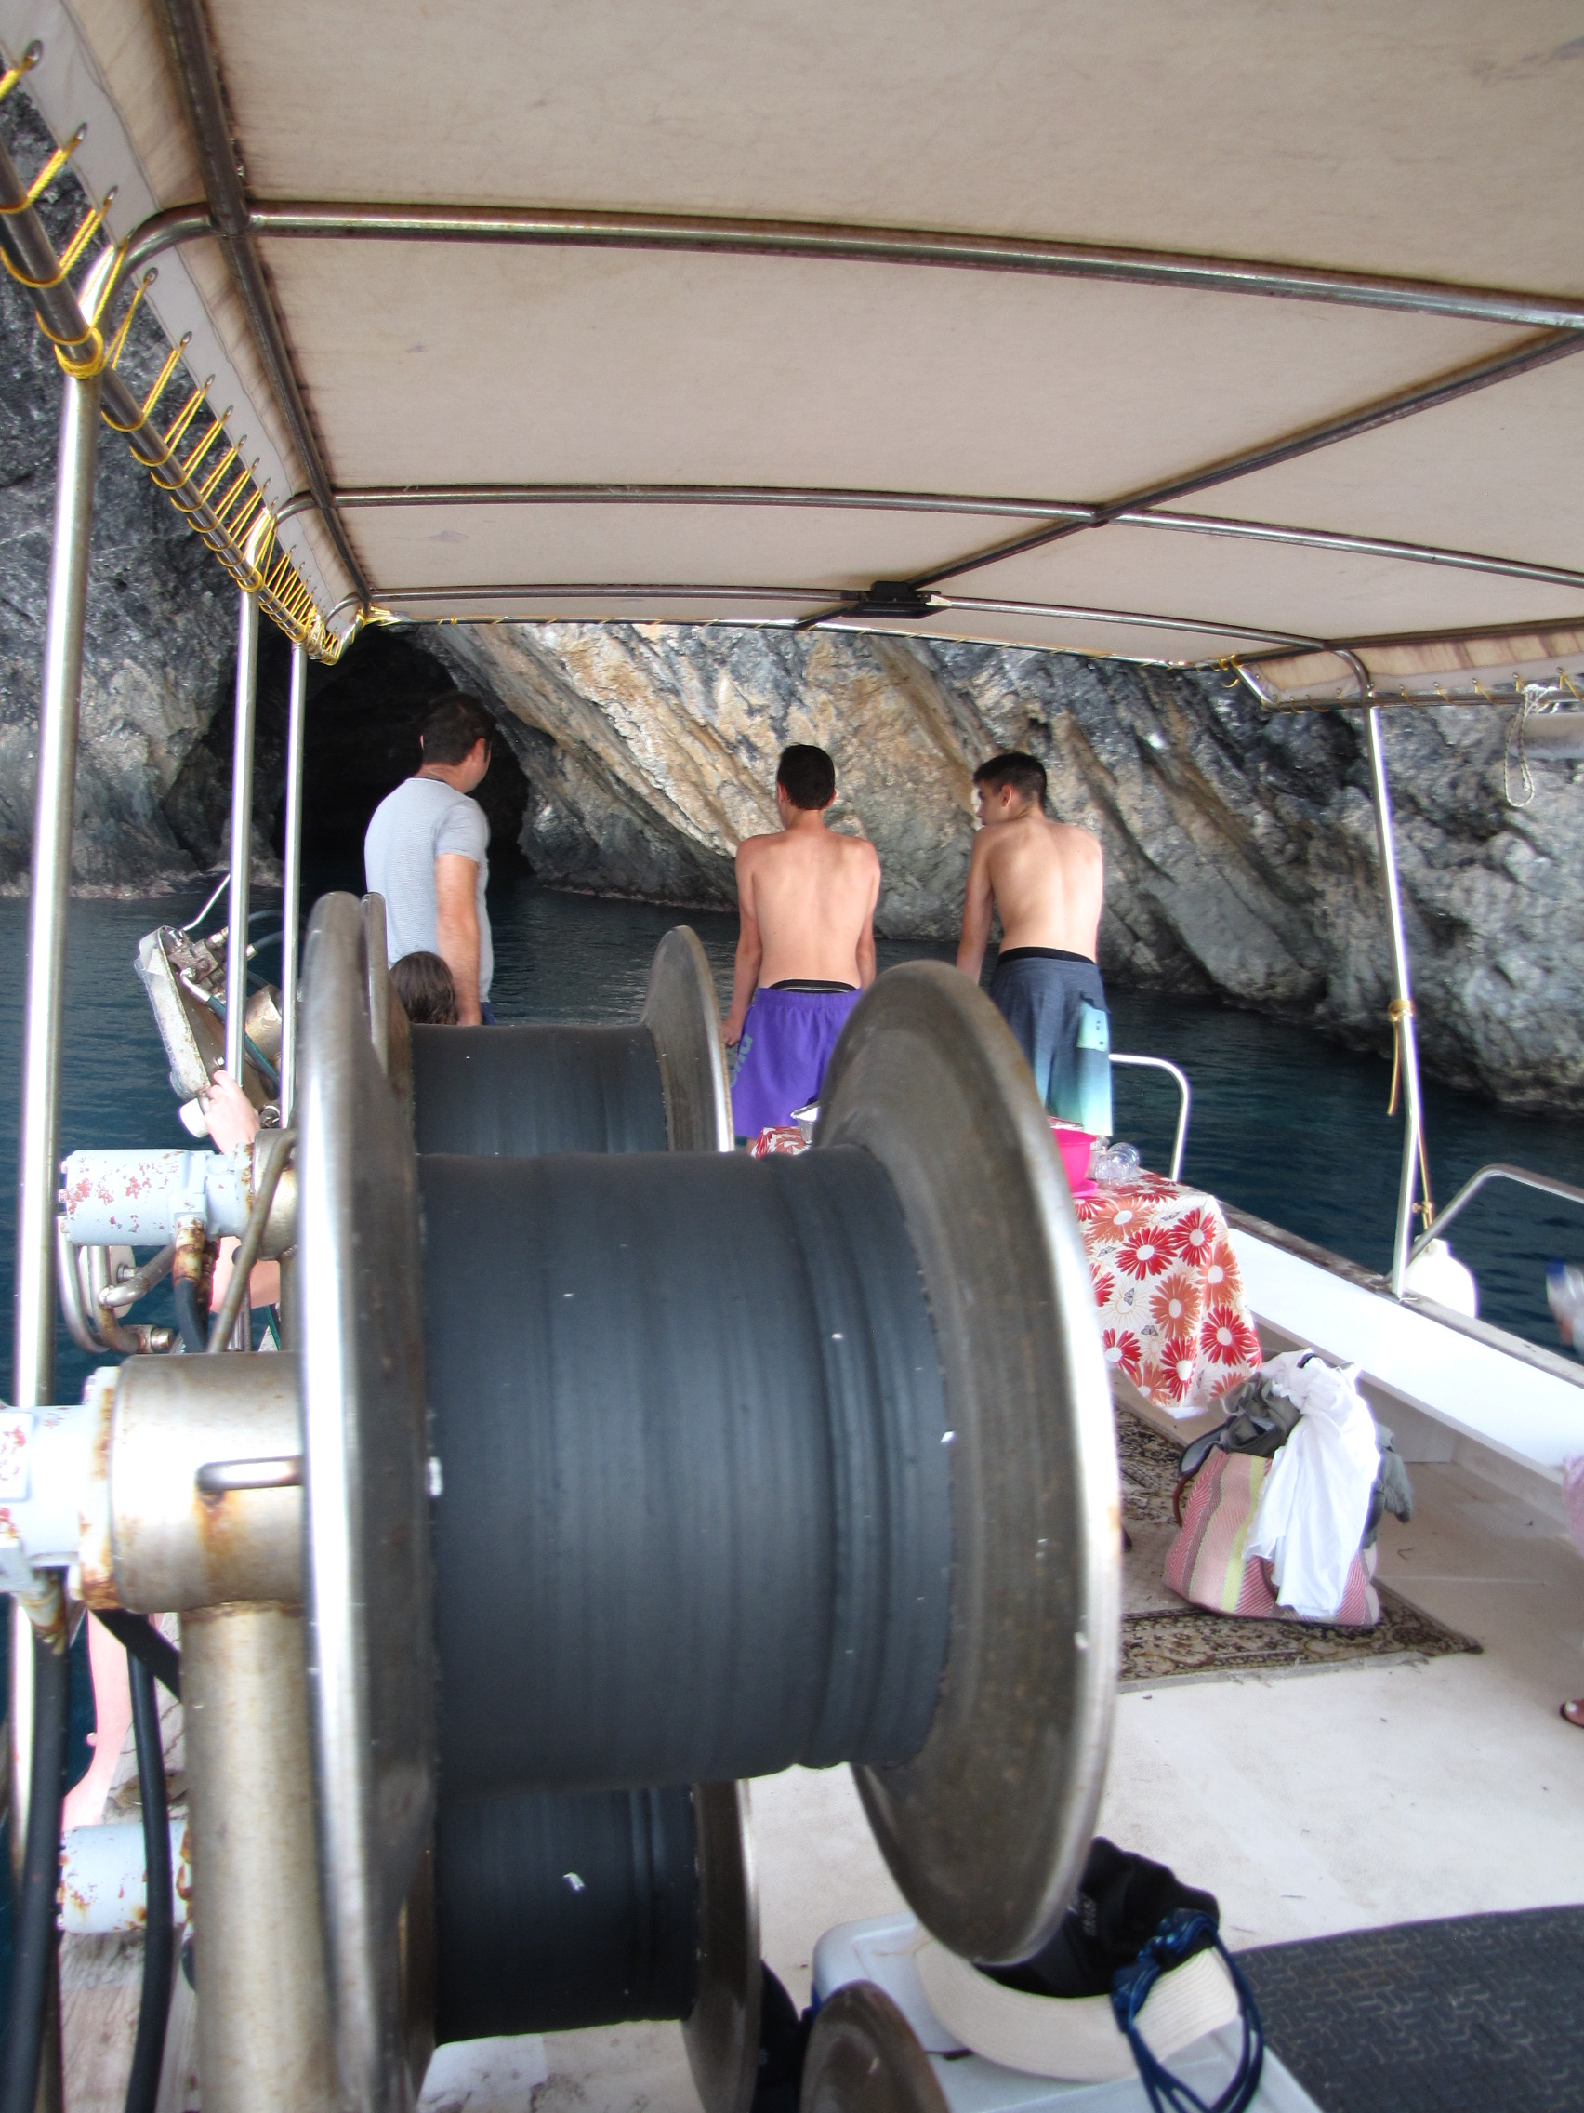
Fishing Tourism
50.000,00€ | 18 LAG
Inter-local - Transnational | Sea & Fisheries Fund: € 135,000.00
Marine Threats
25.000,00€ | 18 LAG
Blue Growth Incubators Network
60.000,00€ | 5 LAG | Greece – Bulgaria

Slide 11
TRANSNATIONAL COOPERATION PROJECT
«Blue Growth Incubators Network»

Slide 12



Blue Growth is the EU 's long - term strategy to support sustainable development in the maritime and maritime sectors as a whole.
The strategy consists of three elements:
Sustainable jobs
Knowledge | Safety
Personalized measures

Slide 13




Purpose of the Blue Growth transnational project:
The creation of an Incubator Network, which will work together to address selected marine challenges in order to support:
Enhancing technological development
Enhancing the competitiveness and viability of maritime and shipping companies
The protection and restoration of aquatic biodiversity | strengthening marine and coastal ecosystems
The development of vocational training

Slide 14






Collaborators
It consists of 7 different groups of local actions (development companies), six of them in Greece and one from Bulgaria coordinated by Attica Islands Network of Municipalities.

Slide 15
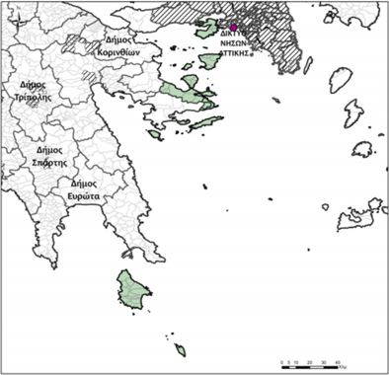
ATTICA ISLANDS NETWORK
Supporting local entrepreneurship and promoting local identity.
Promoting participation, cooperation, networking and exchange of know-how between different regions and partners.
Improving the living conditions and quality of life of the local population.
Enhancing actions and interventions for the environment and climate change.

Slide 16
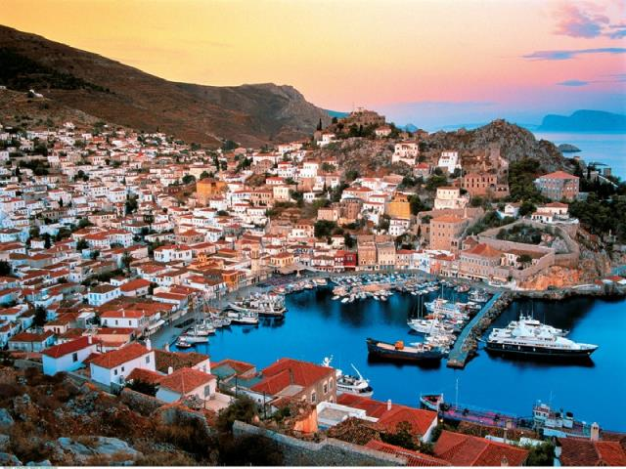
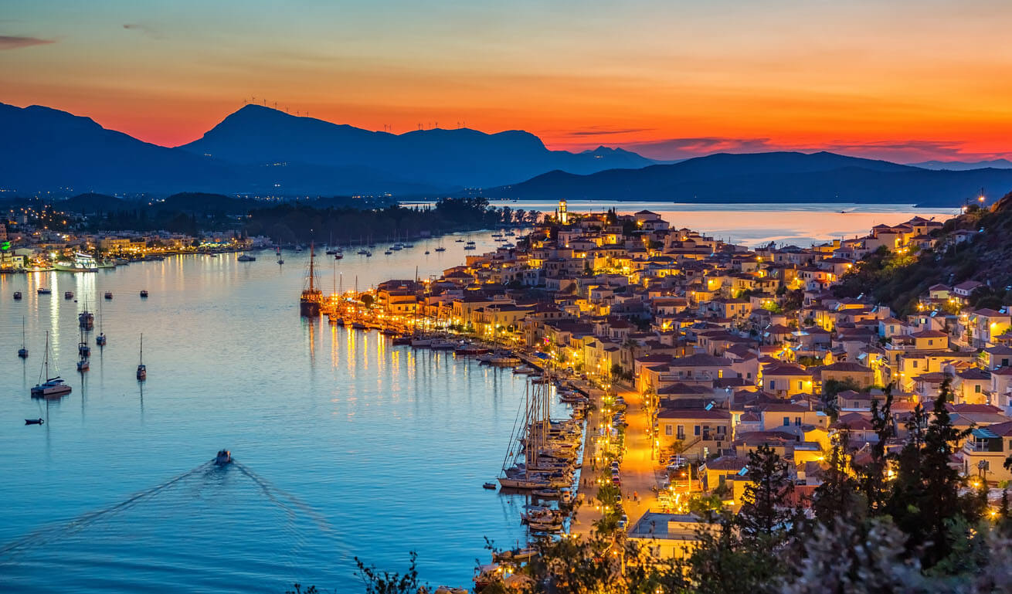

Slide 17
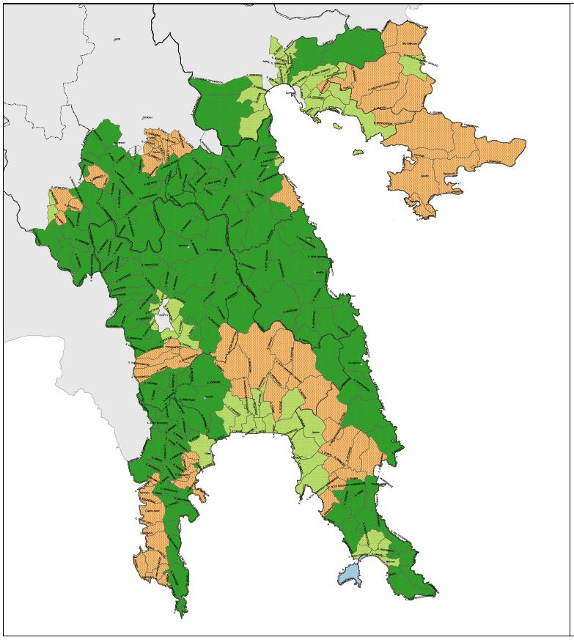
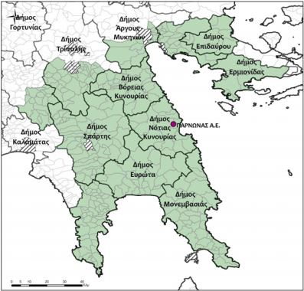
PARNONAS
The scientific and technical support of the Local Authorities. and their associations (eg KEDKE, HSY, TEDK, etc.) and the decentralized state administration.
The promotion of the business, economic and generally sustainable development of the Local Authorities of the Peloponnese Region, ie the Prefectures of Arcadia, Argolis, Laconia, Messinia and Corinth.
The development of environmental protection activities.
Its participation in programs and the implementation of relevant policies at the inter-municipal level or in a wider geographical area.

Slide 18
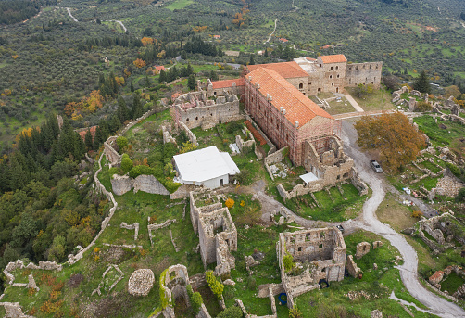
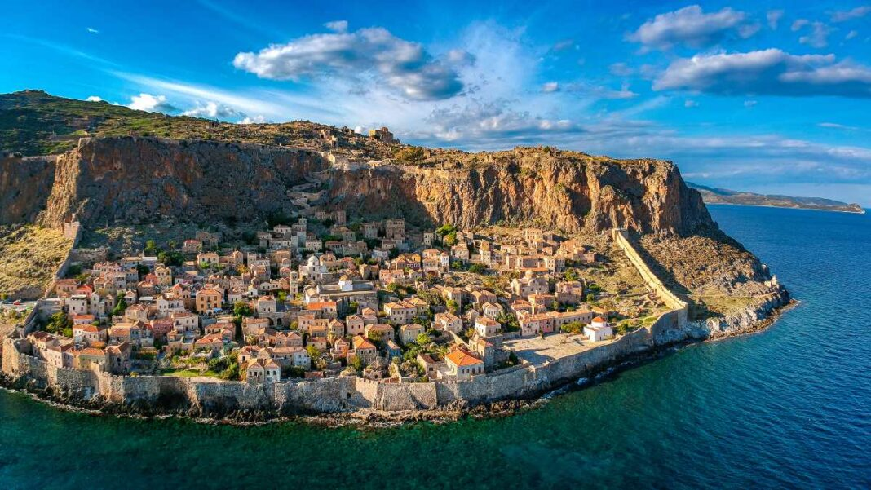

Slide 19
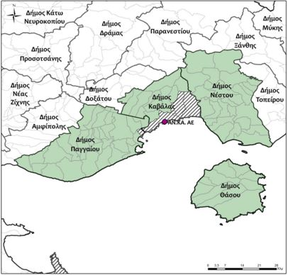
KAVALA
Enhancing entrepreneurship in all sectors of the local economy with emphasis on creating added value in the agri-food sector.
Strengthening the "blue economy".
Upgrading the quality of life and improving the attractiveness of the area.
Innovative design through collaboration and networking.
Development of a distinct and competitive tourism product.
Protection and promotion of the natural and man-made environment.

Slide 20
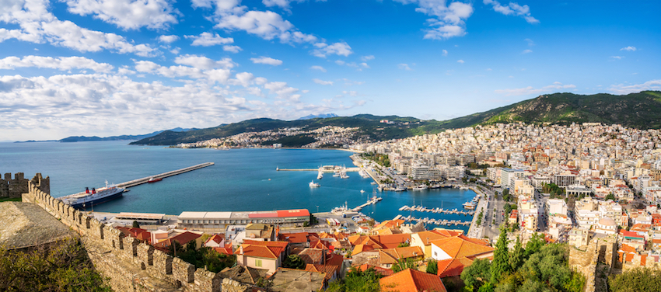
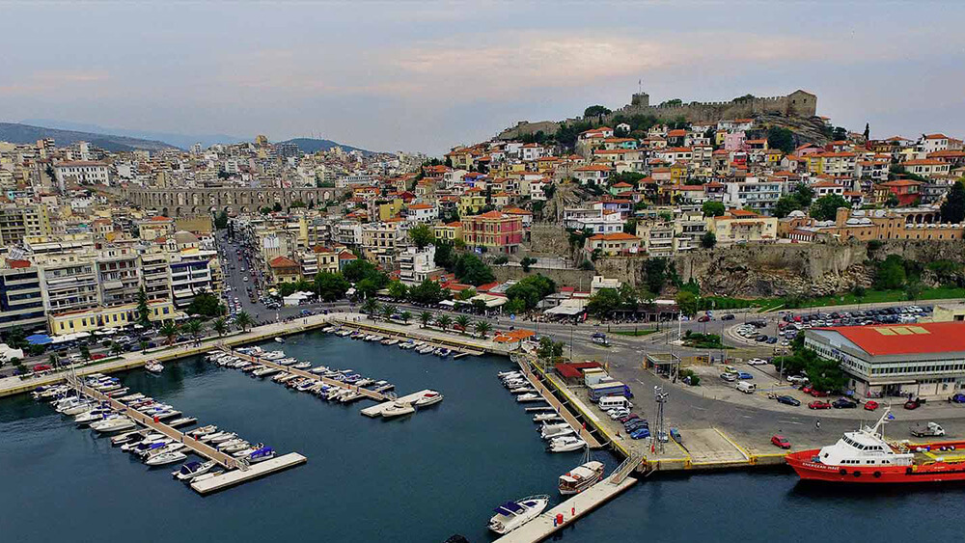

Slide 21
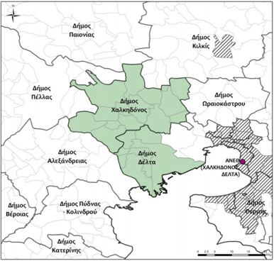


THESSALONIKI (HALKIDONOS, DELTA)
Enhancing competitive entrepreneurship with emphasis on the food sector of the region, utilizing the dynamic local production - agricultural and fisheries - of national importance
Aesthetic upgrade of the built environment, protection and promotion of the international importance of the natural environment, and promotion of the cultural stock, associated with the local production
Encouragement, animation, training and technical support of the local population in general, but especially of entrepreneurs and employees in local businesses, for the development of entrepreneurship and collaborative culture and in general the adaptation to modern socio-economic conditions, with the ultimate goal of creating high and stable employment.

Slide 22
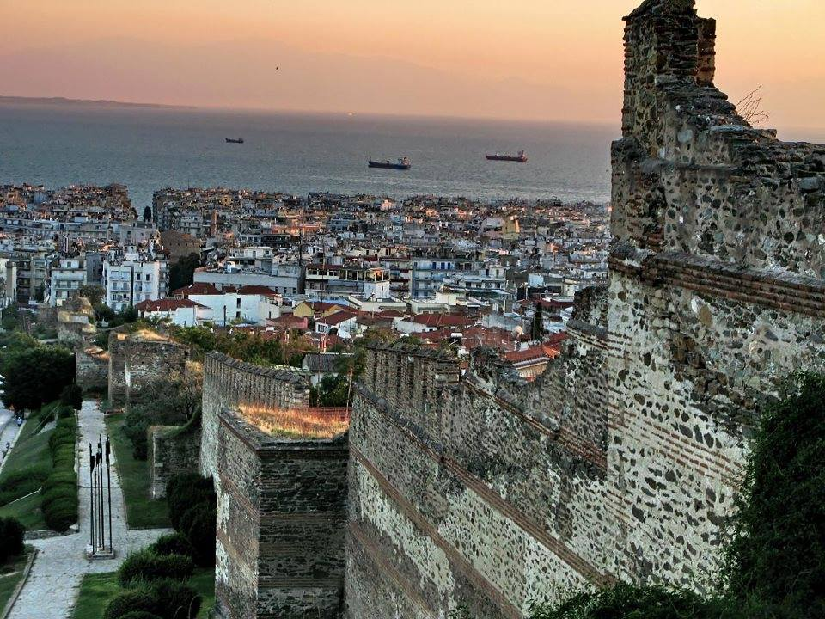
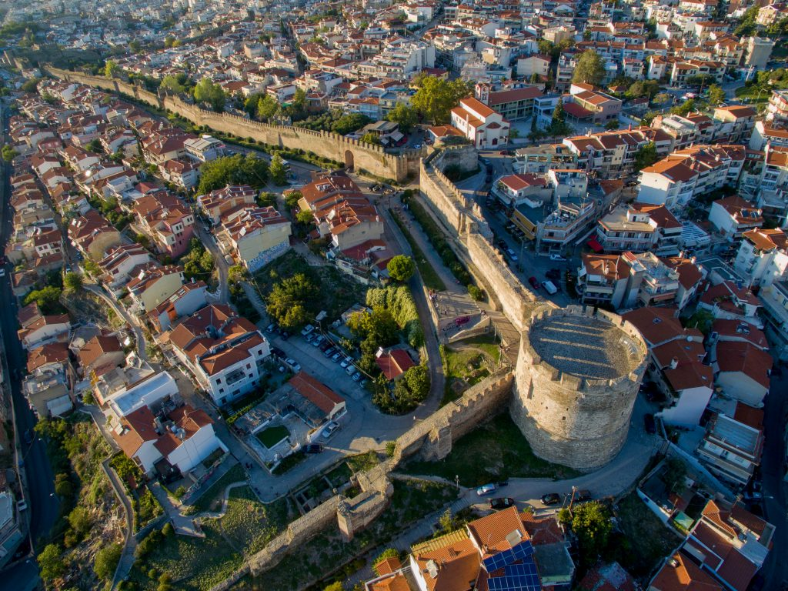

Slide 23
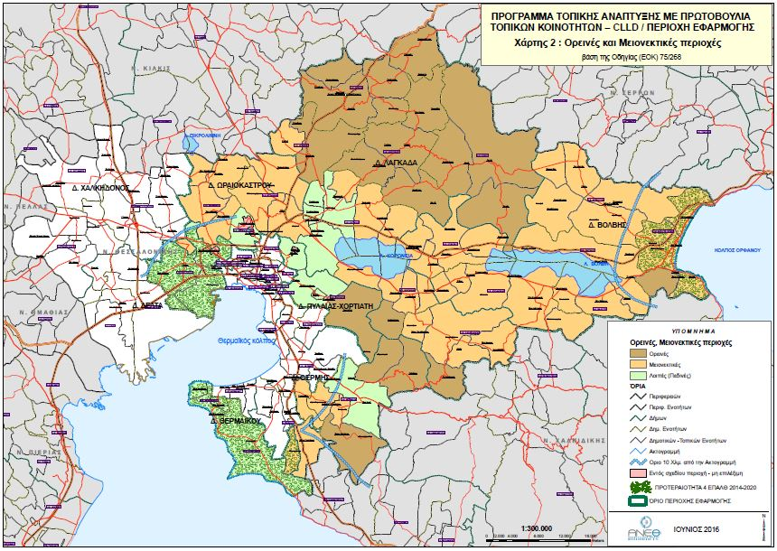
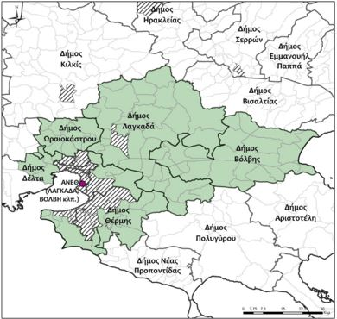
THESSALONIKI (VOLVI)
Enhancing the competitive entrepreneurship of the region with emphasis on strengthening and diversifying the manufacturing sector
Enhance the attractiveness of the area for housing and visit, focusing on the development / upgrade of the necessary technical infrastructure and basic services
Creating conditions for an inclusive development process, supporting local employment and ensuring social cohesion

Slide 24
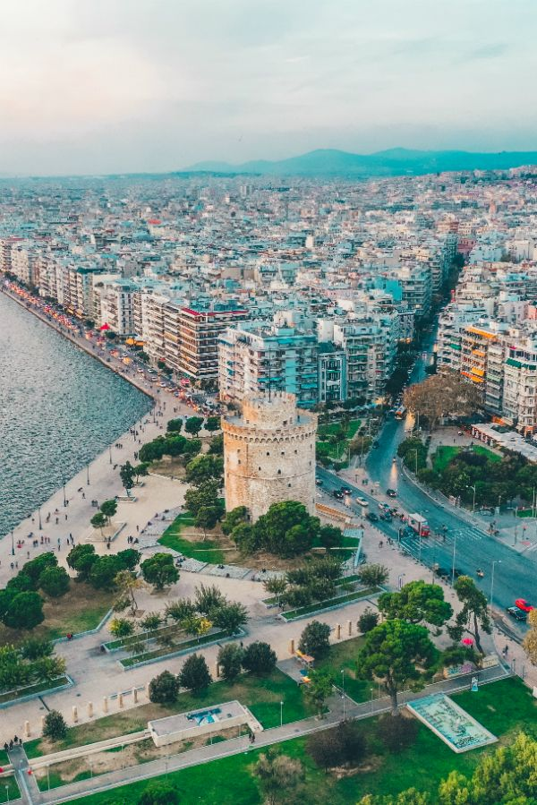
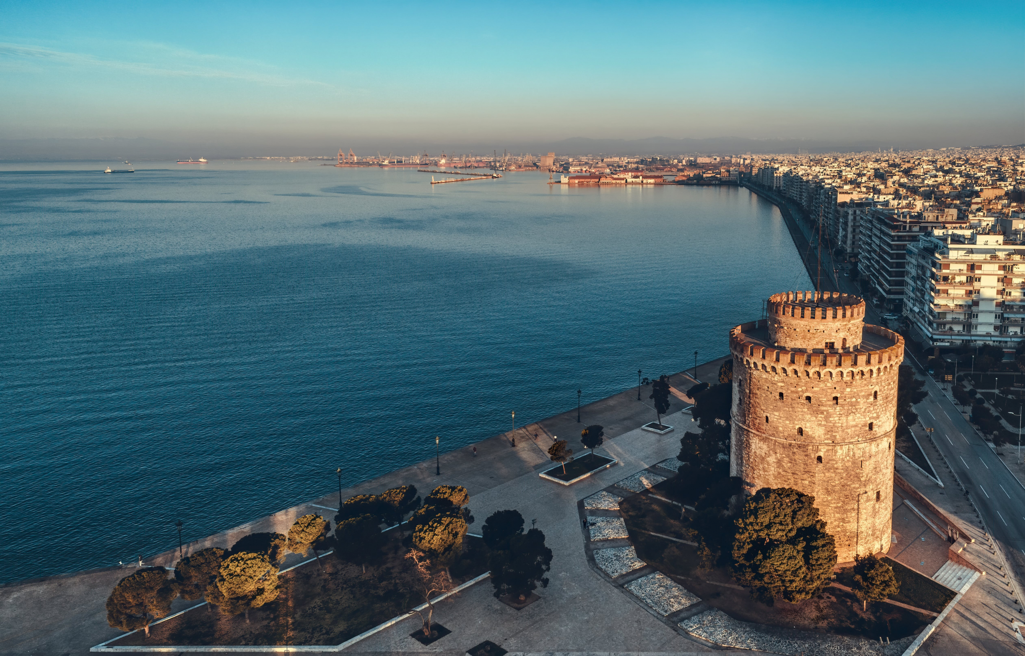

Slide 25
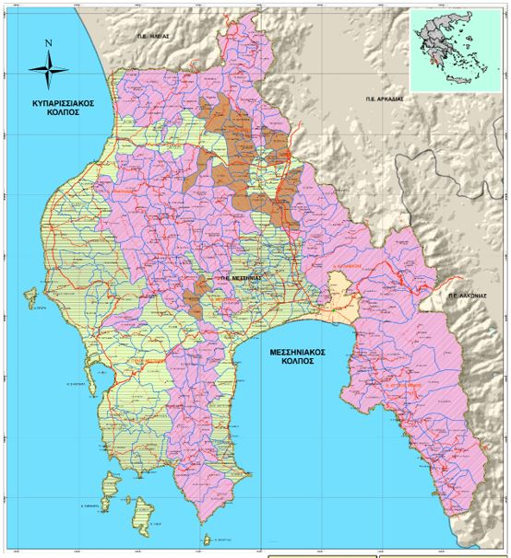
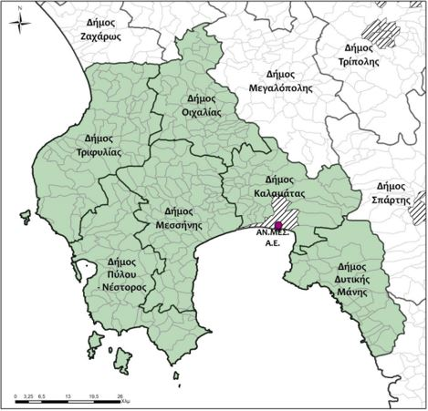
MESSINIA
Improving the quality of life of the inhabitants of the fishing area
Interconnection of a sector with the other productive sectors and the resources of the region
Strengthening networking & export orientation of aquaculture
Development of complementary activities by fishermen
Creation and modernization of manufacturing companies
Creation and modernization of companies in the tertiary sector
Joint interregional and transnational actions of fishing companies

Slide 26
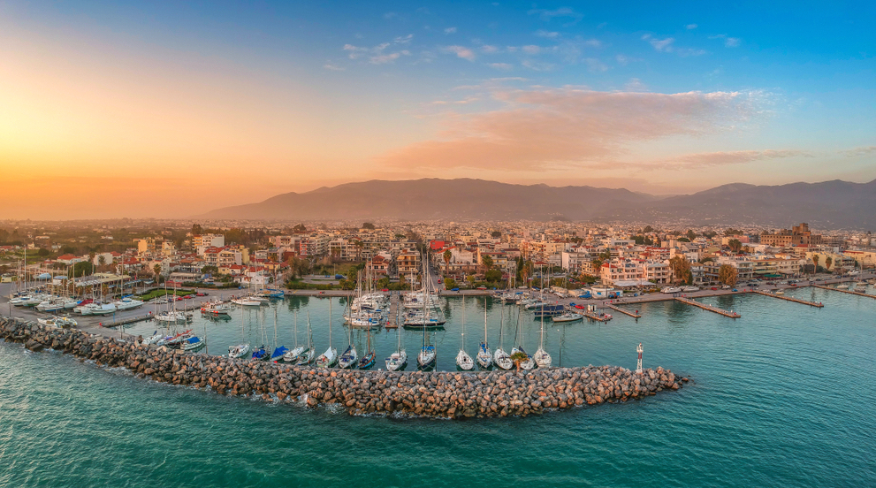
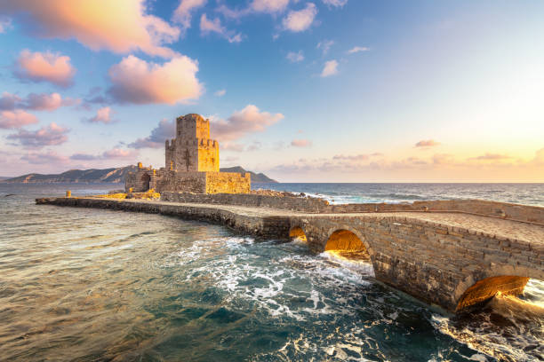

Slide 27
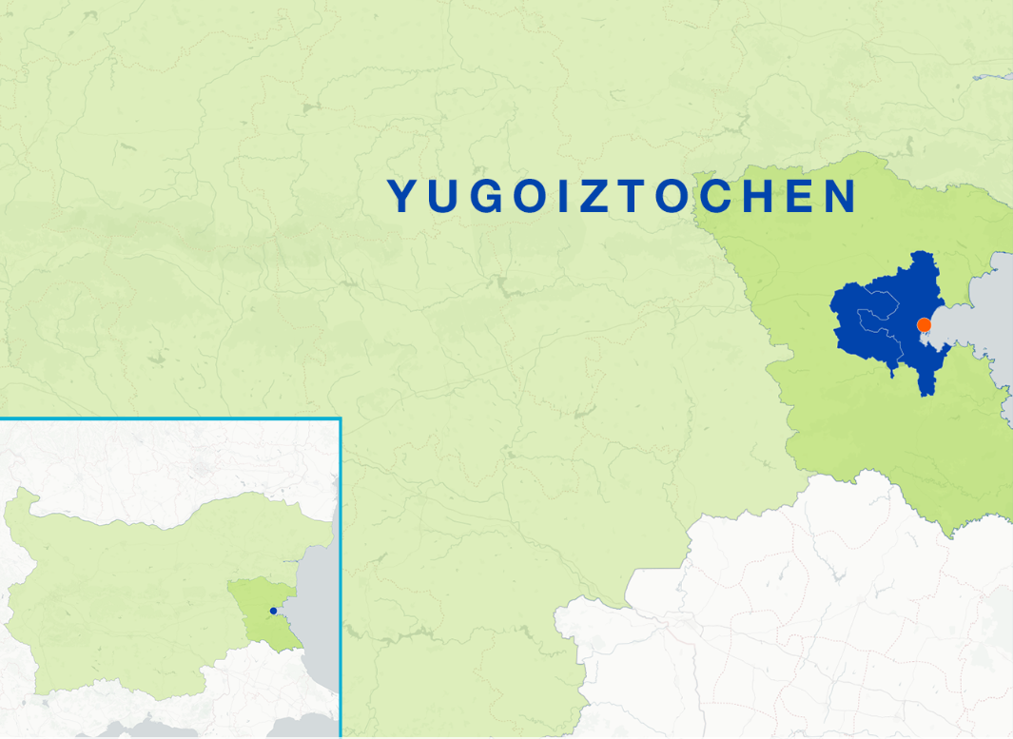
BURGAS
Increasing the competitiveness of the aquaculture sector.
Promoting fisheries and aquaculture innovation.
Support for the diversification of fishing activities.
Creating and maintaining tasks.
Promoting social prosperity and cultural heritage.
Strengthen the governance role of fisheries communities in local development.

Slide 28
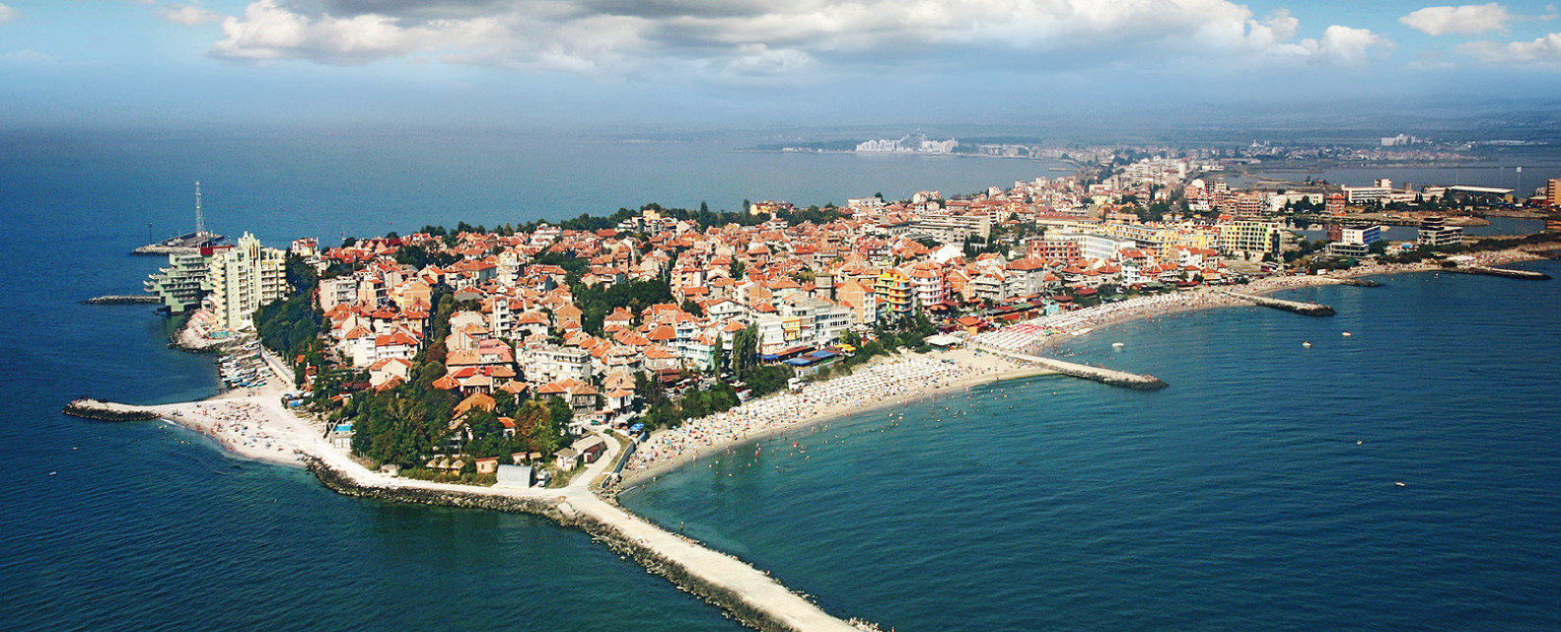
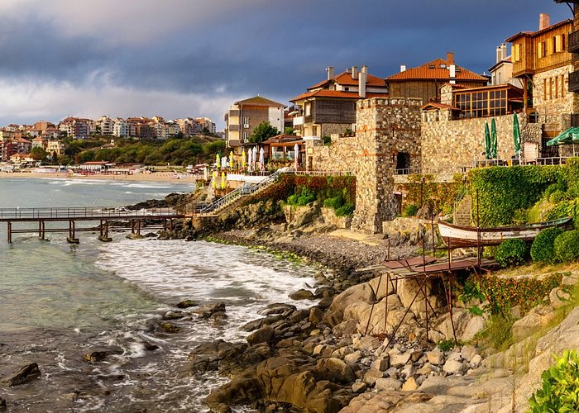

Slide 29
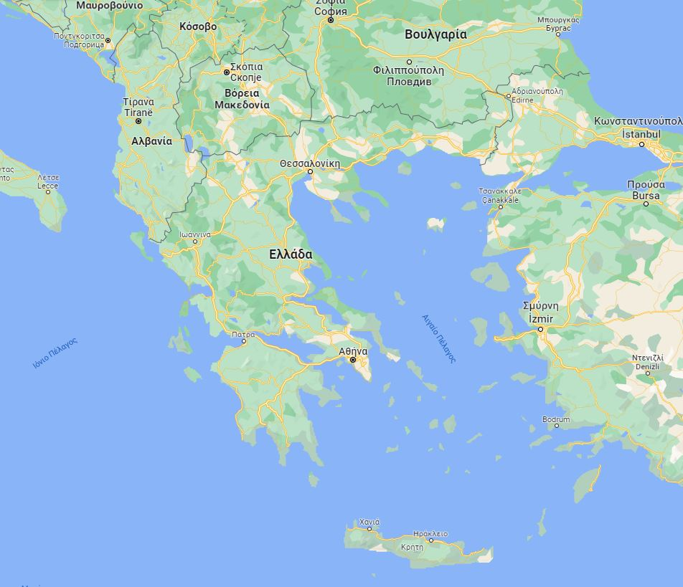

Slide 31
Attica Islands Network of Municipalities
Local Program CLLD/LEADER: «Nature & Culture “On Board”
«Blue Growth Incubators Network»

